Slide 1
Converting Custom Shaders to URP
Andreas Hackel

Slide 2

Notes:
I am a technical artists here at InnoGames an have been working on Sunrise Village the last 5 years. I also wrote most of the shaders for Sunrise Village.
- I recently converted the shaders to the Universal Render Pipeline (or short URP) and I'd like to share some things I have learned with you.

Slide 3
Universal Render Pipeline
Built-in Pipeline (BIRP)
Universal Render Pipeline (URP)
Scriptable Render Pipeline
High Definition Render Pipeline (HDRP)
Custom Scriptable Render Pipeline
Notes:
Pre built Scriptable render pipeline.
Alternative to the builtin render pipeline

Slide 4




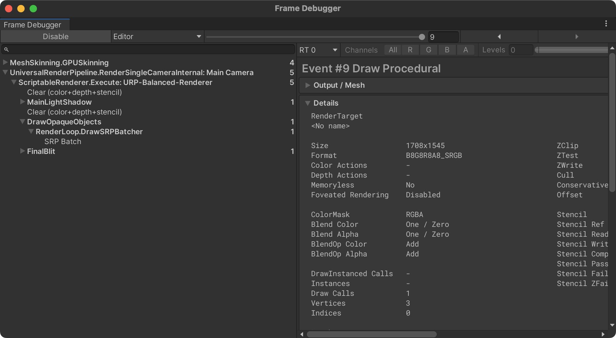
WHY switch?
Faster
Future proof
Customizable
Cleaner Shaders

Slide 5
I have Custom Shaders
You cannot upgrade Custom Unity shaders written for the Built-in Render Pipeline. Instead, custom shaders must be rewritten to work with URP or recreated in ShaderGraph.
https://docs.unity3d.com/Packages/com.unity.render-pipelines.universal@17.0/manual/upgrading-your-shaders.html
Notes:
I am a technical artists here at InnoGames an have been working on Sunrise Village the last 5 years. I also wrote most of the shaders for Sunrise Village.
- I recently converted the shaders to the Universal Render Pipeline (or short URP) and I'd like to share some things I have learned with you.

Slide 6
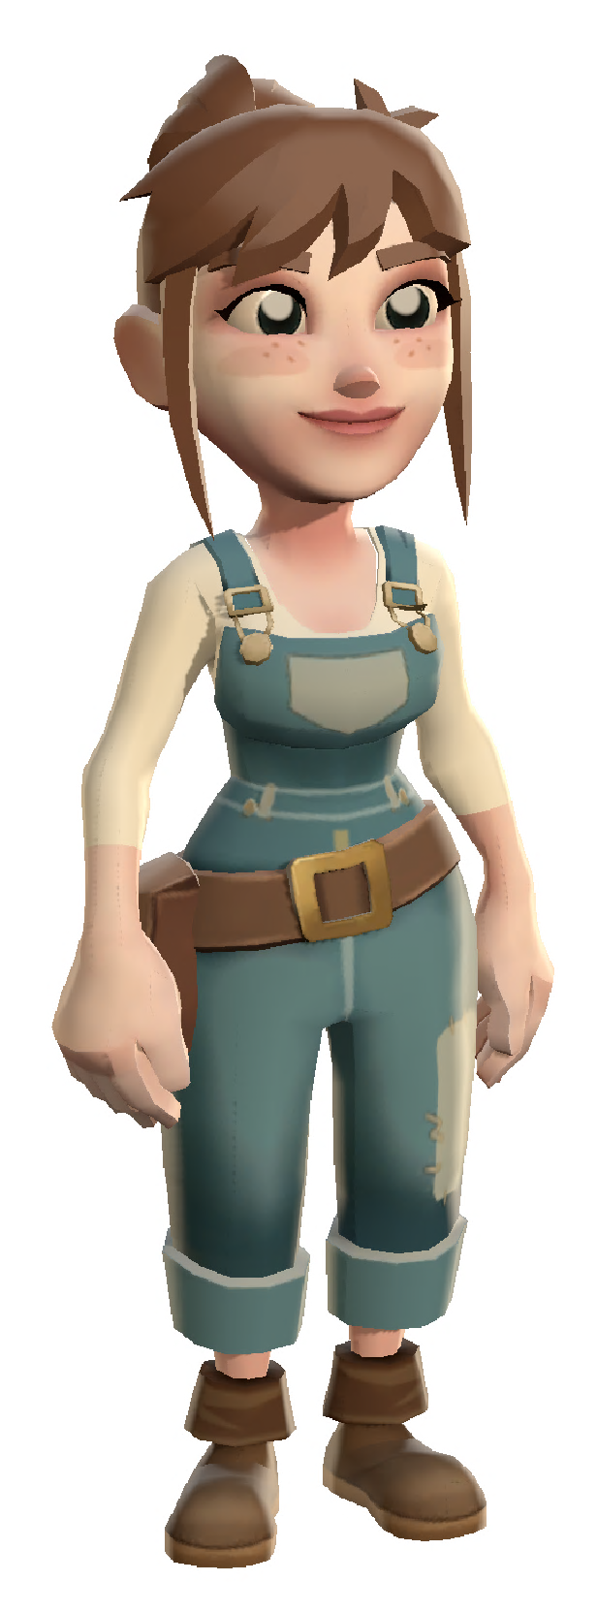
Let’s rewrite together
Hi, I’m Alice
Should look exactly the same
SRP batcher compatible

Slide 7
CHEAT SHEET
https://github.com/innogames/unity-meetup
Notes:
I am a technical artists here at InnoGames an have been working on Sunrise Village the last 5 years. I also wrote most of the shaders for Sunrise Village.
- I recently converted the shaders to the Universal Render Pipeline (or short URP) and I'd like to share some things I have learned with you.

Slide 8
References
Unity Docs: Built-in shaders upgrade guide
https://docs.unity3d.com/Packages/com.unity.render-pipelines.universal@17.0/manual/urp-shaders/birp-urp-custom-shader-upgrade-guide.html
Migrating built-in shaders blog post
https://blog.unity.com/engine-platform/migrating-built-in-shaders-to-the-universal-render-pipeline
Notes:
I am a technical artists here at InnoGames an have been working on Sunrise Village the last 5 years. I also wrote most of the shaders for Sunrise Village.
- I recently converted the shaders to the Universal Render Pipeline (or short URP) and I'd like to share some things I have learned with you.

Slide 9
Questions? Comments?
!?
Notes:
Questions & Comments Slide (built on the chapter slides)

Slide 10
Notes:
Thank You/End slide
Headline mandatory (2-colored (yellow & white))!
- Alternate wording for headline: e.g. „You‘re great!“, „That‘s it for now…“, „End of presentation“

